Slide 1

Will AI take over jobs in SE/CS fields?
CPS PRESENTATION
Laiba Fatima 22k-5195
Amal Abdul Rehman 22k-4822
Sabina Rasheed 22k-5198
Alizah Basit 22k-5155
Bharti Khatri 22k-4832

Slide 2
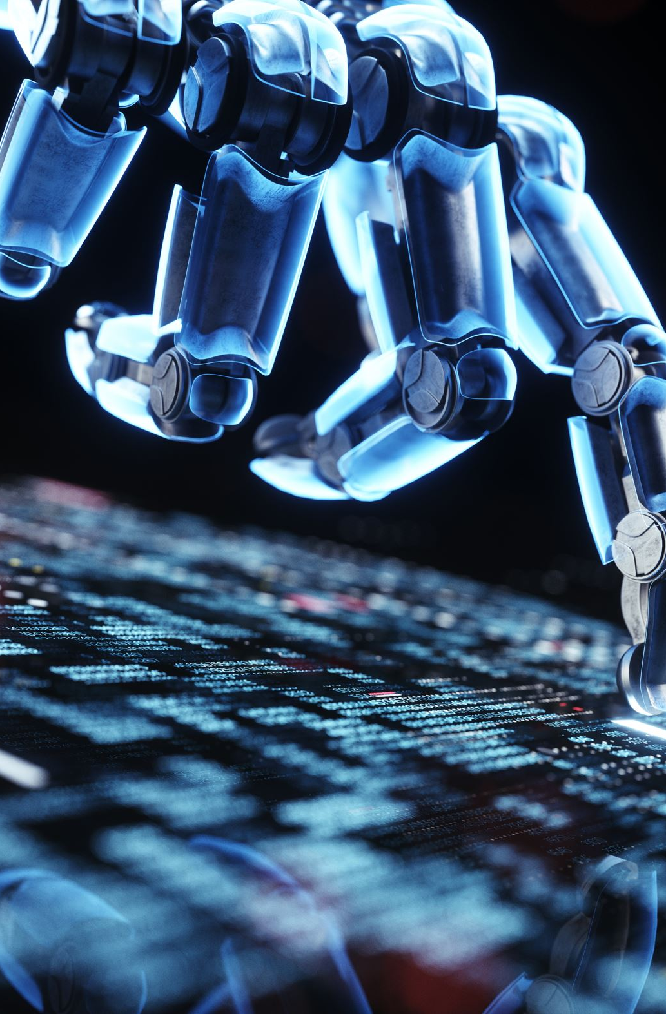
Overview
What is AI?
Define SE
Applications of AI
What can AI do for software engineering?
Where does artificial intelligence fall short?
Conclusion

Slide 3
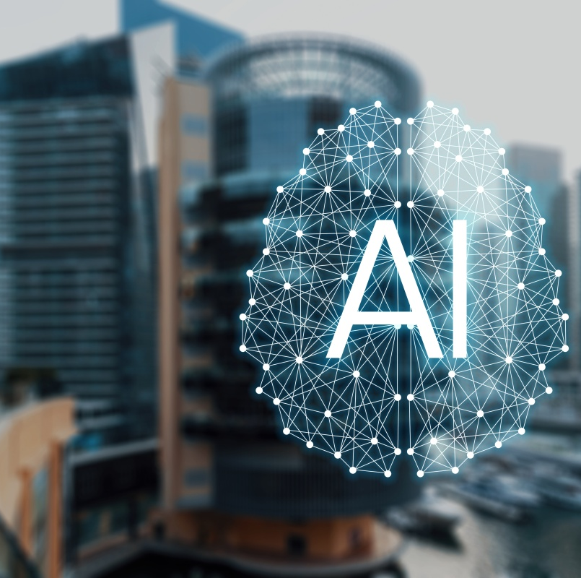
What is Artificial Intelligence?
Machines requiring human intelligence
Speech recognition
Decision making
Translation between languages
Computer behaves as a human

Slide 4
Define SE
Discipline of designing, creating, testing, and maintaining software
Ensure software is built and maintained long-term
Software is secure and resilient
Software is reliable, efficient, maintainable

Slide 5
Applications of AI
Factories and warehouses are primarily run by robots
Cashiers are replaced by electronic kiosks
Self-driving cars

Slide 6
What can AI do for software engineering?
Write code
Create efficient and effective software
Code refactoring
Bug fixing
Unit testing

Slide 7
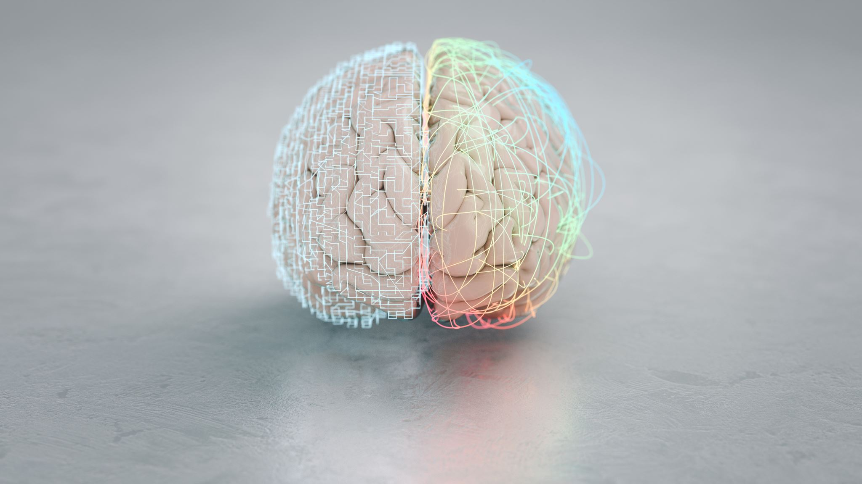
Where does artificial intelligence fall short?

Slide 8

1. AI Lacks Emotional Intelligence
Human characteristic
Emotional connection with clients

Slide 9

2. AI Can Only Work with Inputted Data
Functions based on data it receives
Unforeseen circumstances

Slide 10
3. AI’s Creative Process Is Limited to the Data It Receives
Cannot think up new ways of doing work
Restricted to the given templates
Creativity is important for innovation
Humans think outside the box
Teamwork
Critical thinking
Effective communication
Interpersonal skills
Design AI
4. AI does not have soft skills

Slide 11
5. Humans make AI work
Input data
Operate the system
Maintain AI
Design AI

Slide 12
Learn to Work With AI, Not Fear It
Be innovative and creative
Polish your skills
AI may automate many tasks
But unlikely to replace SE/CS jobs

Slide 13
THANK YOU!

